Slide 1
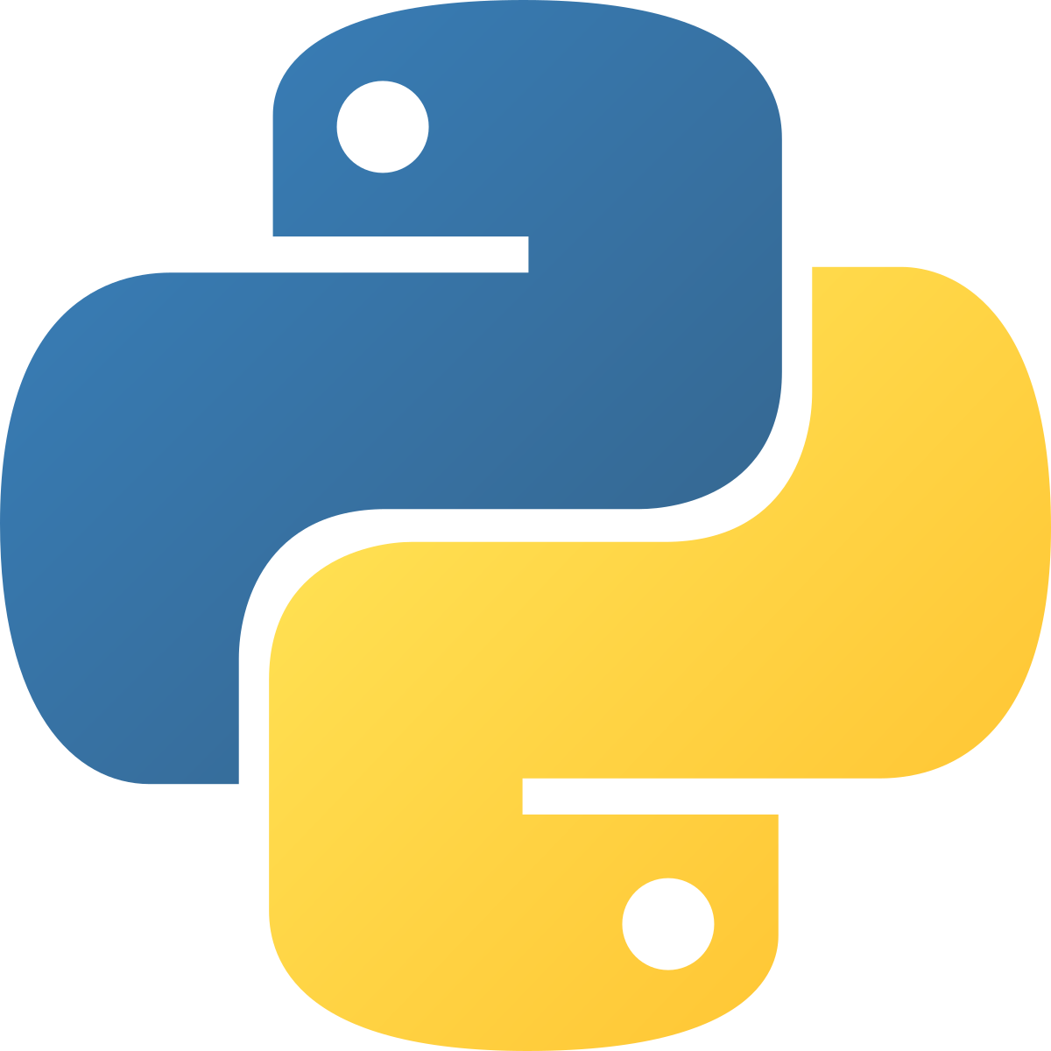
IMAGE TO TEXT CONVERTER
PYTHON FULL STACK DEVELOPMENT
UNDER THE GUIDANCE OF
Dr. Geeta Singh
REVIEW 1

Slide 2
TEAM MEMBERS
2110030217 – G.SRI VARDHAN REDDY
2110030256 – R. SATYA SAI
2110030209 – ALLU JYOTHI SWAROOP
2110030307 – CH. DILEEP REDDY

Slide 3

PROBLEM STATEMENT
Online Image to Text converter is proposed here which allows to convert any Text-image to Text.
We are using OCR (Optical Character Recognition) technology used in AI.
The proposed system shows an user interface and update the text with given images.

Slide 4
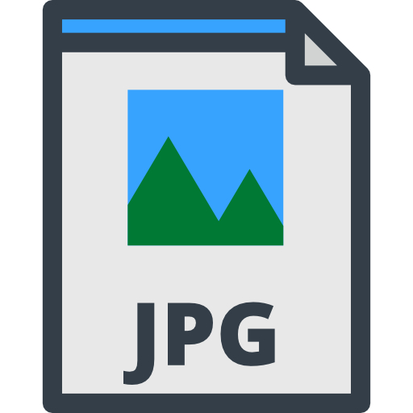
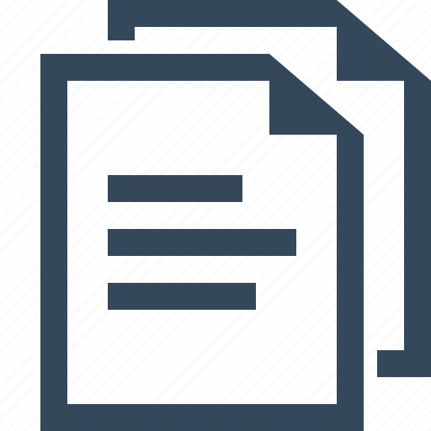

LITERATURE REVIEW
This Image to text converter project is made by using OCR (Optical Character Recognition) software technology used in AI, in python IDE.
The user can upload an image if a web like interface is made and the program on run, recognizes the characters and converts into text.
The output is then stored in a file.

Slide 5
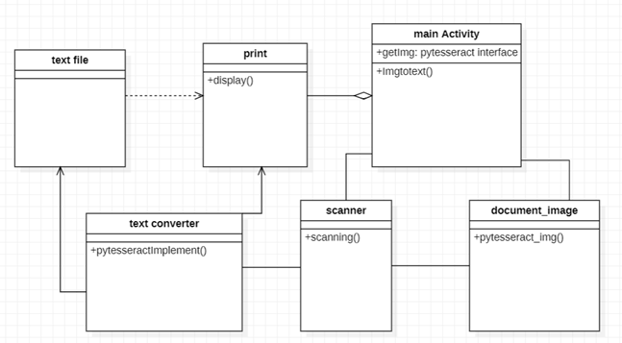
CLASS DIAGRAM
As shown in the diagram, the class- main activity runs at last and shows the result. It is in aggregation with print class since every process till then is run and processed output is shown in it.
Dependency can be seen since the class text file needs to send the output to print class

Slide 6
DATASET COLLECTION AND TOOLS REQUIRED
Information was collected from several websites.
Star UML
Python FLASK
Pytesseract and open-cv packages

Slide 7
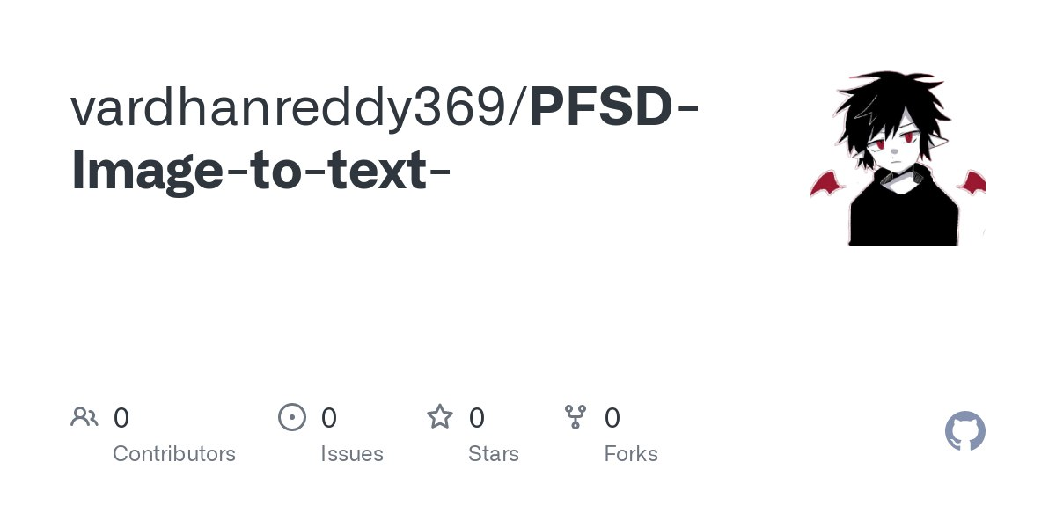
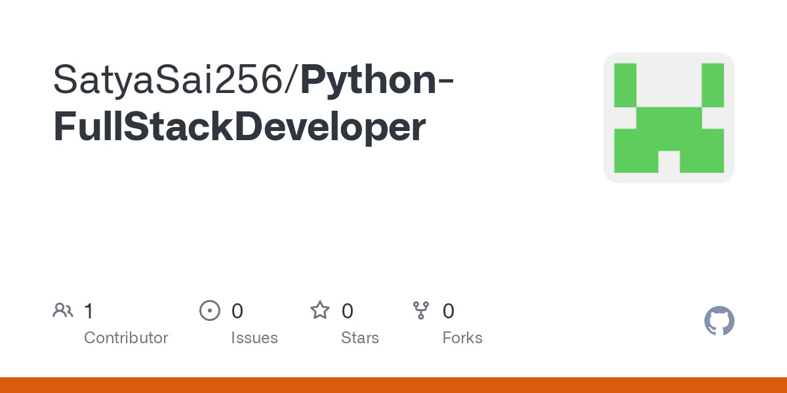
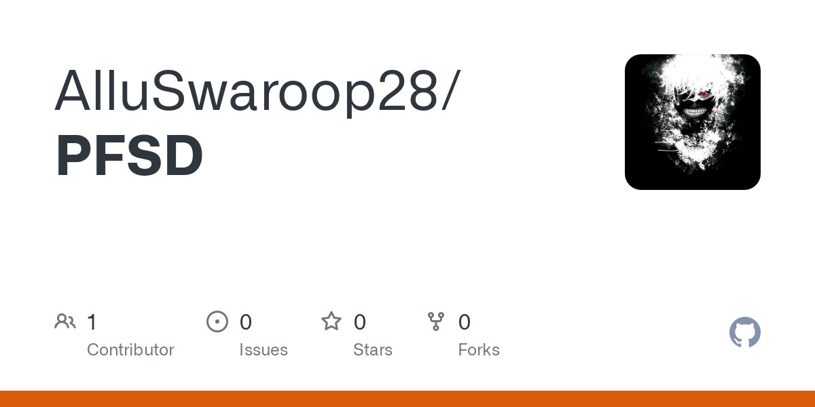
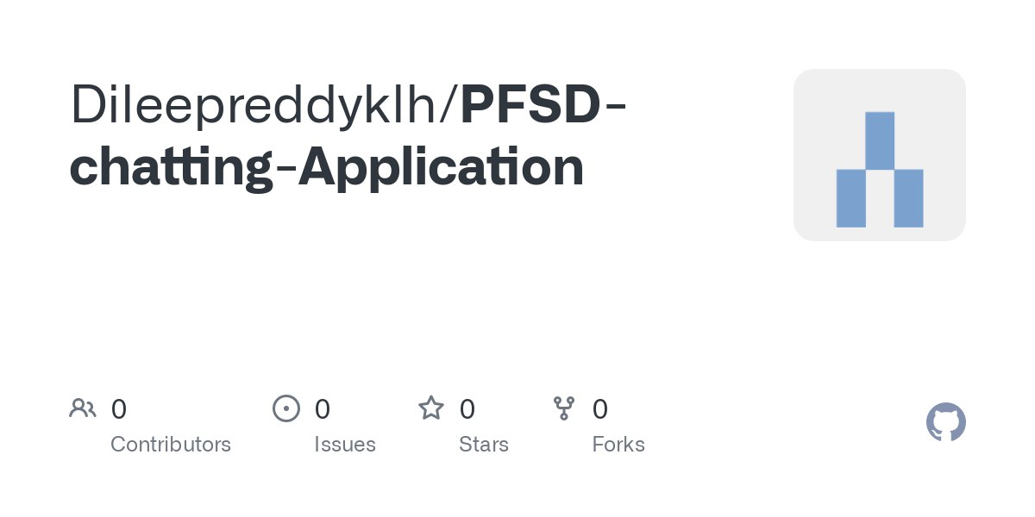
GitHub SETUP

Slide 8
DIVISION OF WORK
Class diagram- G. Sri Vardhan Reddy
Literature Review- R. Satya Sai
Data Set Collection- Allu Jyothi Swaroop
Problem Statement- Ch. Dileep Reddy

Slide 9
